Slide 1

CSCI E-25 Computer Vision
Stereogeometry and 3-D Computer Vision
Steve Elston
Copyright 2022, 2023, 2024, 2025, Stephen F Elston. All rights reserved.

Slide 2
3-D Computer Vision
Stereogeometry and 3-D CV algorithms attempt to construct 3-D models of the real world
Real-world scenes are 3-dimensional
Objects in the real-world scatter light from 3-D surfaces
Real-world objects are at different locations in the 3-D world
Cameras use 2-D sensor arrays measure incident light
Image is inherently 2-D!
Must use multiple camera poses to understand 3-D scenes

Slide 3
3-D Computer Vision
Stereogeometry and 3-D CV algorithms attempt to construct 3-D models of the real world
3-D CV uses two or more camera poses to create 3-D models
3-D CV has many applications:
Autonomous vehicles
Robotics
Augmented reality
Scanning 3-D shapes of real objects
Medical imaging
Etc…
3-D CV is now dominated by deep NN models
Task is closely related to image stitching

Slide 4
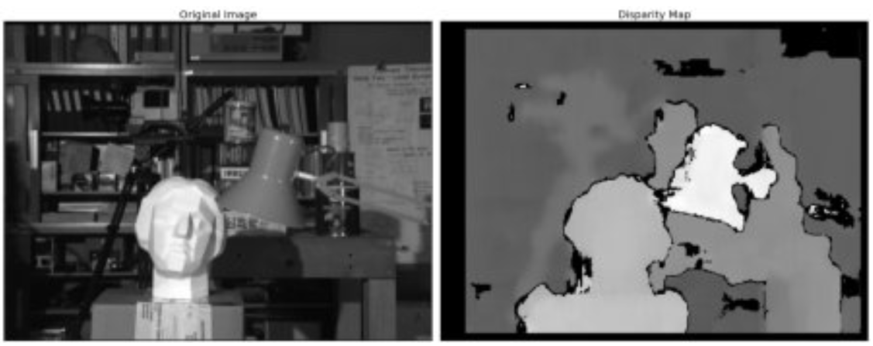
3-D Computer Vision
Example: Depth map of room scene from stereo camera pair
From: https://docs.opencv.org/4.x/dd/d53/tutorial_py_depthmap.html

Slide 5
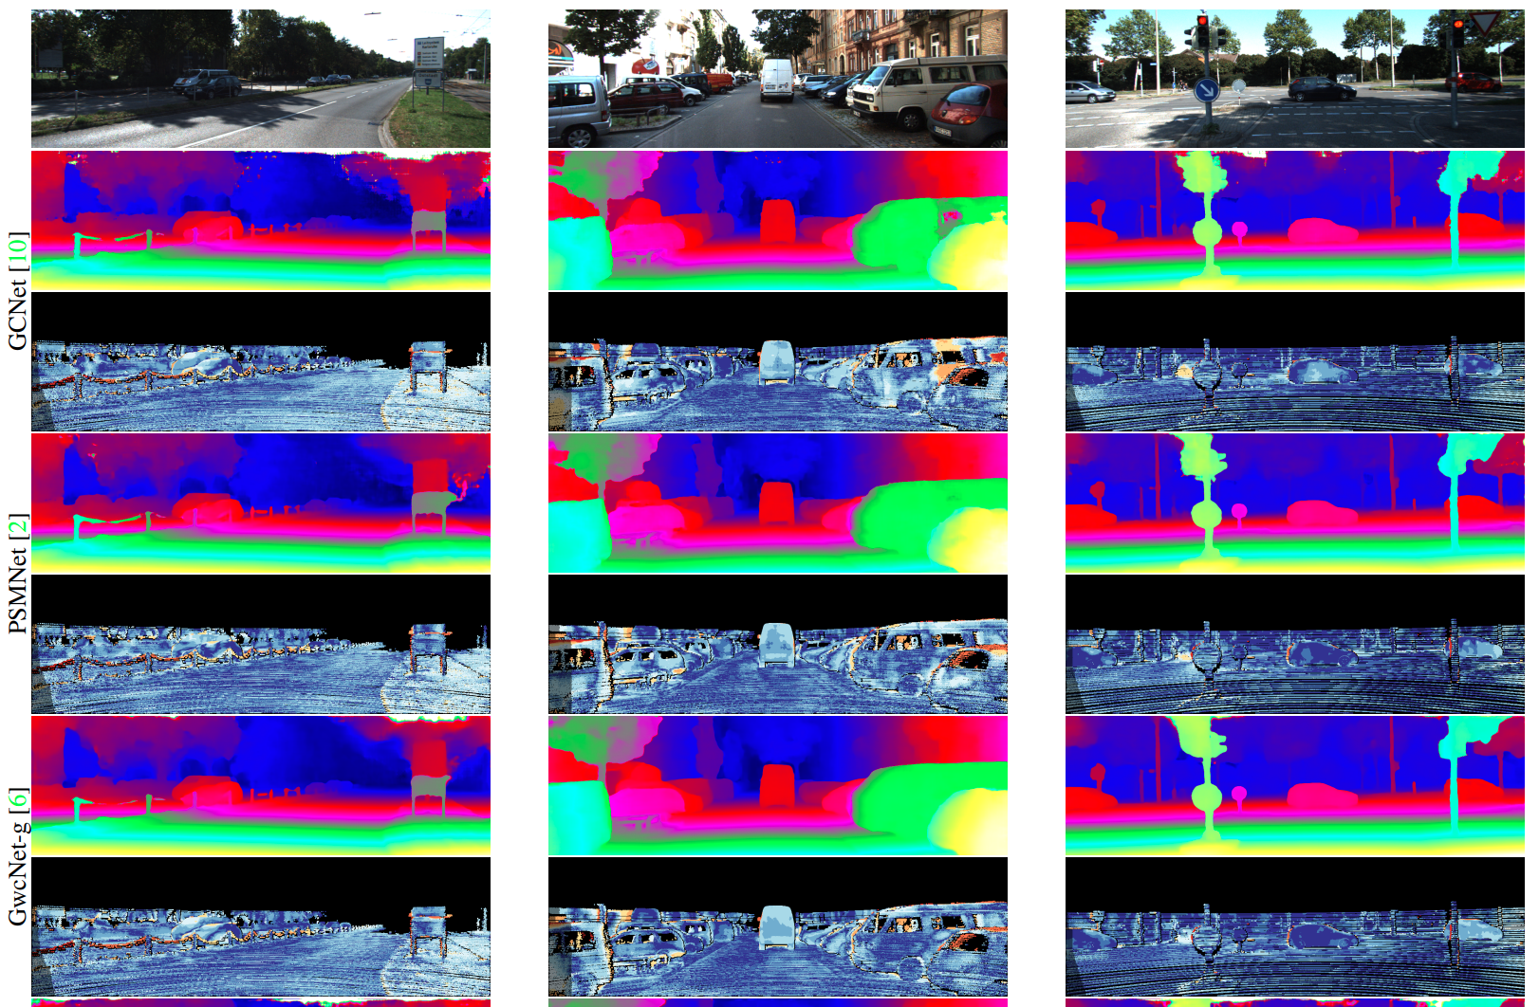
3-D Computer Vision
Example: Depth maps for autonomous vehicle navigation
From: Shamsafar, et. al., 2021

Slide 6
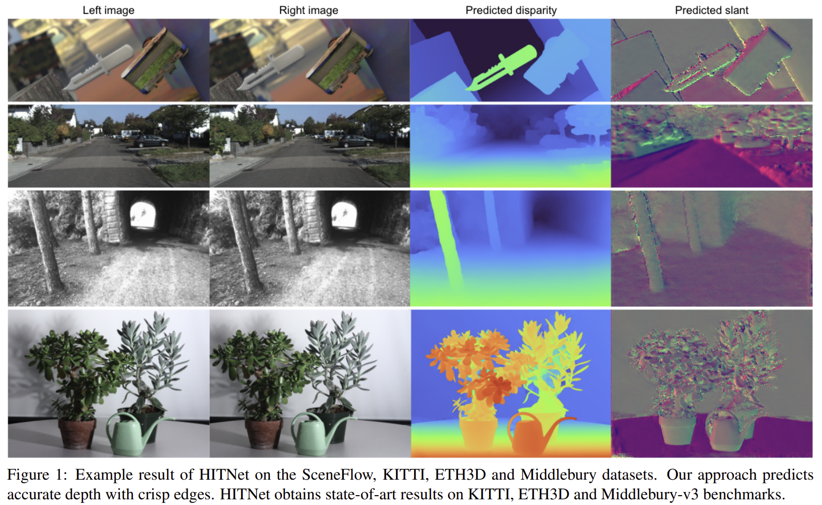
HITnet
The Hierarchical Iterative Tile Refinement Network (HITnet) of Tankovich et. al., 2023, is nearly the state of the art
Qualitative results
Results shown for 4 benchmark datasets
Notice the high resolution at multiple scales

Slide 7
3-D Computer Vision
Overview of lesson
What methods can we use for 3-D CV models?
Geometry of depth estimation
Epipolar geometry for 3-D vision
Image rectification for disparity estimation
Evaluation of depth estimation models
Why use binocular vision?
Depth estimation with deep neural networks
Example: MobileStereoNet
Example: HITnet

Slide 8
3-D Computer Vision
Approaches to 3-D CV
Active sensing – beyond our scope
Radar
Lidar
Expensive
Limited range and resolution
Often integrate with optical methods
Moving camera or object
Extension of optical flow

Slide 9
3-D Computer Vision
Passive approaches to 3-D CV
Monocular methods
Use properties of single image
Area of considerable research
Multiple camera poses
Use 2 or more camera poses
Solve inverse projection problem
We focus on 2 camera or stereo vision case

Slide 10
3-D Computer Vision
Difficulties with 3-D CV
Limited baseline limits depth accuracy
Closer distances estimated more accurately
Longer baseline helps but not always possible
Images with low gradient; matching key points between left and right difficult
Repetitive patterns makes key point matches ambiguous
Real-world lighting, shadow and poor contrast
Shadows are particularly troublesome
Poor contrast areas have low gradient
Reflective surfaces distort apparent depth

Slide 11
3-D Computer Vision Bibliography
Selections from the large and expanding literature
Deeper Depth Prediction with Fully Convolutional Residual Networks, Laina, et.al., 2016,
Pyramid Stereo Matching Network, Chang and Chen, 2018
On the Importance of Stereo for Accurate Depth Estimation: An Efficient Semi-Supervised Deep Neural Network Approach, Smolyanskiy, et.al., 2020
MobileStereoNet: Towards Lightweight Deep Networks for Stereo Matching, Shamsafar, et.al., 2021
HITNet: Hierarchical Iterative Tile Refinement Network for Real-time Stereo Matching, Tankovich, et.al., 2023
A Survey on Deep Stereo Matching in the Twenties, Tosi, Bartolomie, and Poggi, 2024

Slide 12
3-D Computer Vision Bibliography
Selections from the large and expanding literature
Classical stereo vision
The 14_StereoVision_classical.pptx slides in the course GitHub repository
Mathew O’Toole’s CMU CS 16-385 lecture notes
Many other important papers under the Papers with Code Stereo Depth Estimation task
LIDAR integration
DeepFusion: Lidar-Camera Deep Fusion for Multi-Modal 3D Object Detection, Li, et.al., 2022

Slide 13
3-D Computer Vision Bibliography
Samples from the large and expanding literature
Monocular depth estimation
High Quality Monocular Depth Estimation via Transfer Learning, Alhashim and Wonka, 2019
Randomly connected neural networks for self supervised monocular depth estimation, Tukra and Giannarou, 2021
Depth Anything: Unleashing the Power of Large-Scale Unlabeled Data, Yang, et. al., 2024
Depth Anything V2, Yang, et. al., 2024
Survey on Monocular Metric Depth Estimation, Zhang, 2025
Papers with Code, Monocular depth estimation

Slide 14
Geometry of Depth Estimation

Slide 15
Stereo Vision Problem
Stereo vision is a canonical problem in computer vision
Can locate a point in 3-D space from location on 2 or more image planes
Solving this problem requires a model for the cameras
Solve for point locations in 3-D space
w
Image plane 1
Image plane 2
x₁
x₂
Optical center 1
Optical center 2

Slide 16
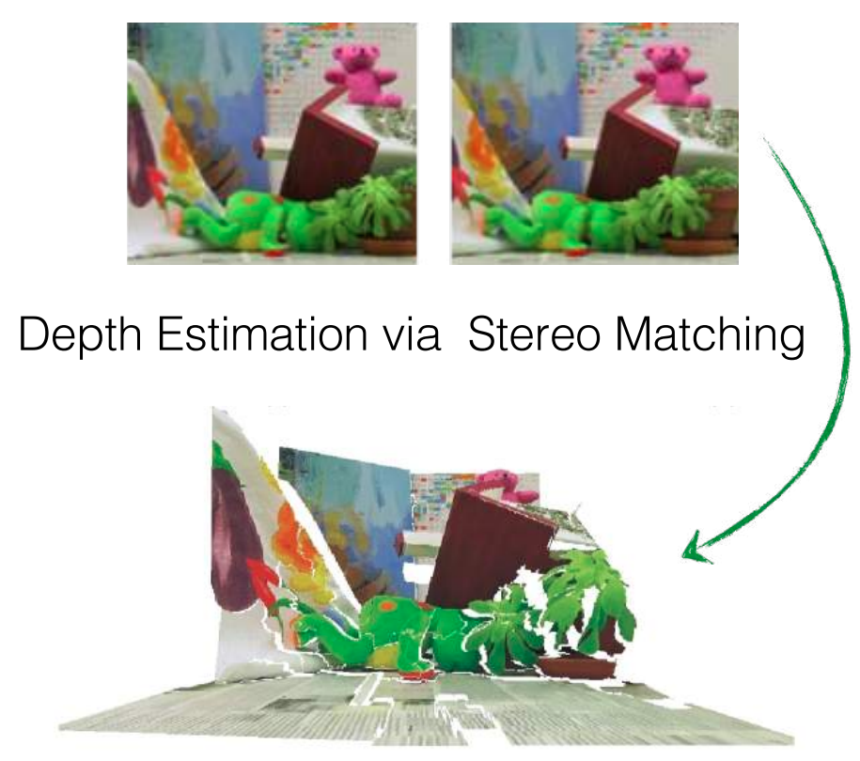
Stereo Depth Estimation
Example: Depth estimation from stereo pair matching

Slide 17
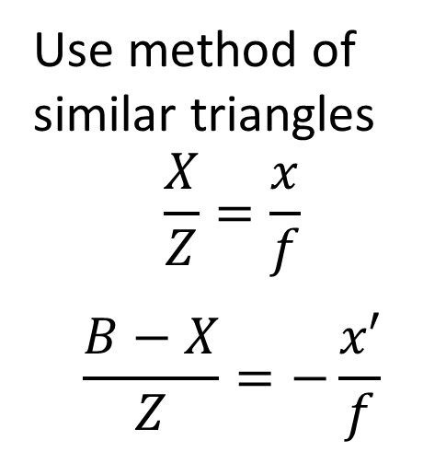
Stereo Depth Estimation
To create a 3-D scene must rectify the cameras
When cameras are rectified the image planes are coplanar
With rectified images can triangulate distance to each point on the image plane
Use method of similar triangles
$$\frac{X}{Z}=\frac{x}{f}$$
$$\frac{B−X}{Z}=−\frac{x′}{f}$$
Z
x
x’
f
Image Planes
X
O
O’
Baseline, B

Slide 18
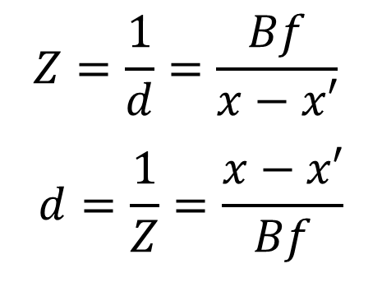
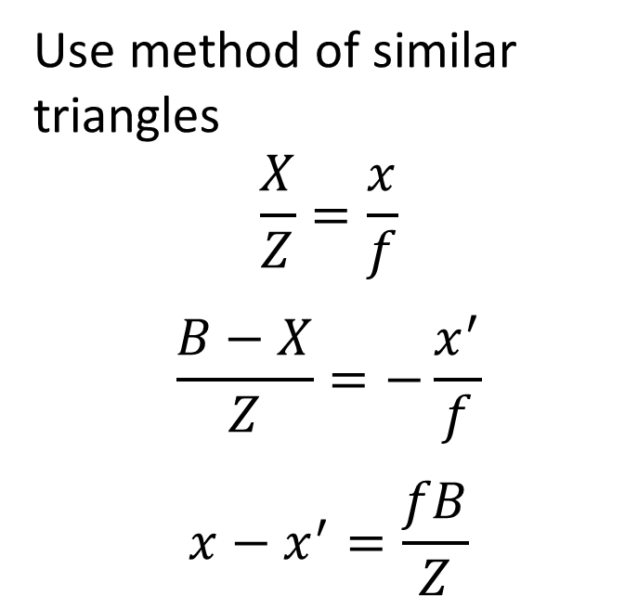
Stereo Depth Estimation
Use disparity to compute depth from rectified images
Depth, Z, is the inverse of disparity, d
Use method of similar triangles
$$\frac{X}{Z}=\frac{x}{f}$$
$$\frac{B−X}{Z}=−\frac{x^{′}}{f}$$
$$x−x^{′}=\frac{fB}{Z}$$
$$Z=\frac{1}{d}=\frac{Bf}{x−x′}$$
$$d=\frac{1}{Z}=\frac{x−x′}{Bf}$$
Z
x
x’
f
Image Planes
X
O
O’
Baseline, B

Slide 19
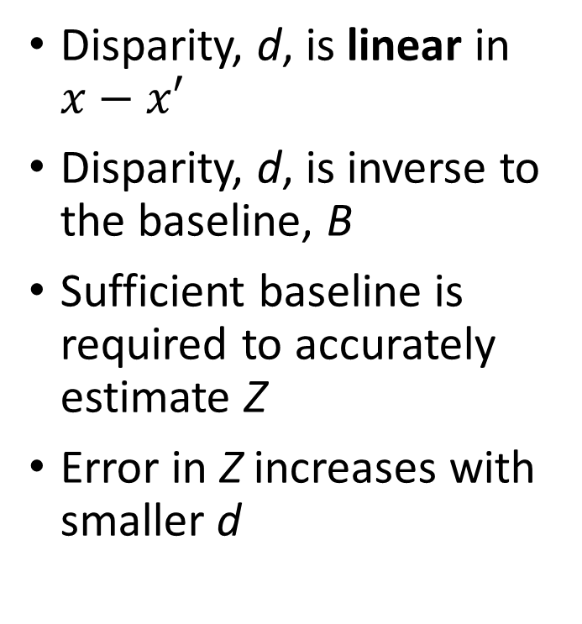
Stereo Depth Estimation
Use disparity to compute depth from rectified images
Depth, Z, is the inverse of disparity, d
Disparity, d, is linear in $x−x′$
Disparity, d, is inverse to the baseline, B
Sufficient baseline is required to accurately estimate Z
Error in Z increases with smaller d
$$Z=\frac{1}{d}=\frac{Bf}{x−x′}$$
$$d=\frac{1}{Z}=\frac{x−x′}{Bf}$$
Z
x
x’
f
Image Planes
X
O
O’
Baseline, B

Slide 20
Epipolar Geometry for 3-D Vision

Slide 21
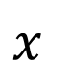
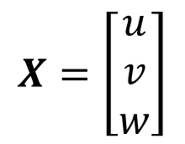
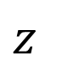
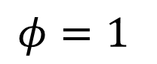
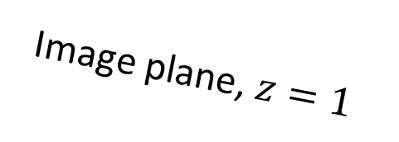
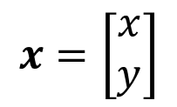
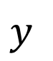
Review: Pinhole Camera Model
Homogeneous coordinates for a pinhole camera model
Image plane, $z=1$
$$X=\left[\begin{matrix}u \\ v \\ w\end{matrix}\right]$$
Pinhole at origin
$$x=\left[\begin{matrix}x \\ y\end{matrix}\right]$$
O
$$z$$
Principle Point
Optic Axis
$$x$$
$$y$$
$$φ=1$$

Slide 22
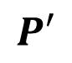
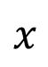


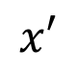
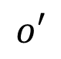
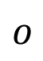
Epipolar Geometry
Epipolar geometry is the basis for 3-D image construction
Start with a point in space X
Point projected, with camera matrix P, at point x on image plane of camera 1 with optical center o
Point projected, with camera matrix P’, at point x’ on image plane of camera 2 with optic center o’
$$X$$
$$P$$
$$P′$$
$$x$$
$$x′$$
$$o$$
$$o′$$

Slide 23
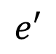
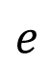
Epipolar Geometry
Epipolar geometry is the basis for 3-D image construction
Start with two camera poses
Baseline connects optic centers of cameras
Baseline crosses the image planes at the epipodes, e, e’
The points X, o, and o’ define the epipolar plane
$$X$$
$$P$$
$$P′$$
$$x$$
$$x′$$
$$o$$
$$e$$
$$e′$$
$$o′$$

Slide 24
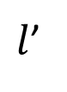
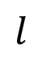
Epipolar Geometry
Epipolar geometry is the basis for 3-D image construction
Start with two camera poses
Epipolar lines connect epipodes to image points, e to x and e’ to x’
Epipolar lines lie in the epipolar plane
Notice that the epipolar lines are slanted on the image plane
$$X$$
$$P$$
$$P′$$
$$x$$
$$x′$$
$$l$$
$l$’
$$o$$
$$e$$
$$e′$$
$$o′$$

Slide 25
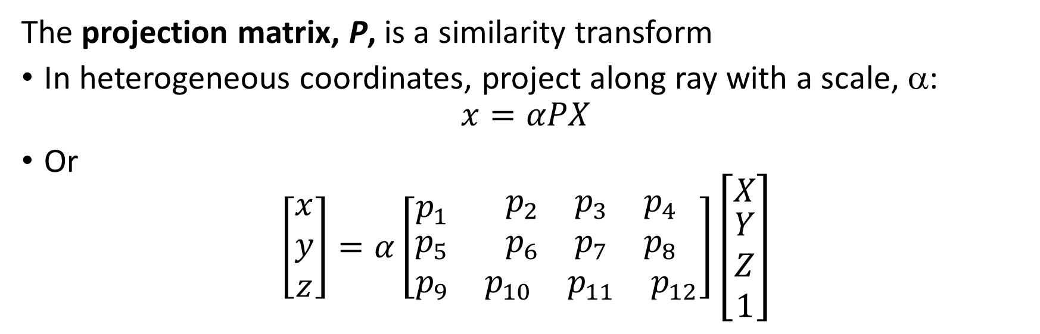
Projections to Camera Coordinates
The projection matrix, P, is a similarity transform
In heterogeneous coordinates, project along ray with a scale, α:
$$x=αPX$$
Or
$$\left[\begin{matrix}x \\ y \\ z\end{matrix}\right]=α\left[\begin{matrix}p_{1} & \begin{matrix}p_{2} & p_{3} & p_{4}\end{matrix} \\ \begin{matrix}p_{5} \\ p_{9}\end{matrix} & \begin{matrix}\begin{matrix}p_{6} & p_{7} & p_{8}\end{matrix} \\ \begin{matrix}p_{10} & p_{11} & p_{12}\end{matrix}\end{matrix}\end{matrix}\right]\left[\begin{matrix}X \\ \begin{matrix}Y \\ Z \\ 1\end{matrix}\end{matrix}\right]$$
$$X$$
$$P$$
$$P′$$
$$x$$
$$x′$$
$$l$$
$l$’
$$o$$
$$e$$
$$e′$$
$$o′$$

Slide 26
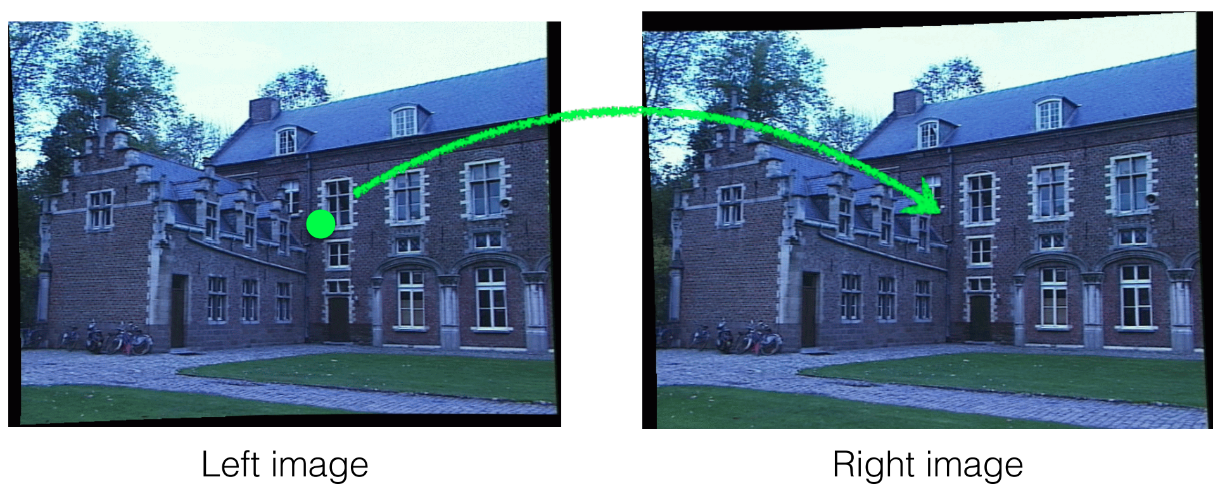
Finding Matching Points
We need to find matching points between the left and right images
Credit, Kris Kitani - CMU

Slide 27
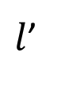
Finding Matching Points
We need to find matching points between the left and right images
Do we need to search entire pair of images for matching points?
No! We only need to search along the epipolar line, l’
Enforce the epipolar constraint
$$X$$
$$P$$
$$P′$$
$$x$$
$$x′$$
$$l$$
$l$’
$$o$$
$$e$$
$$e′$$
$$o′$$

Slide 28
Image Rectification

Slide 29
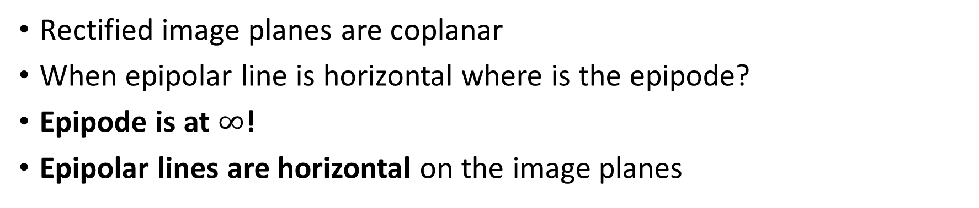
Rectification of images
Rectified images have horizontal epipolar lines
Rectified image planes are coplanar
When epipolar line is horizontal where is the epipode?
Epipode is at $∞$!
Epipolar lines are horizontal on the image planes
X
x
x’
Baseline, t

Slide 30
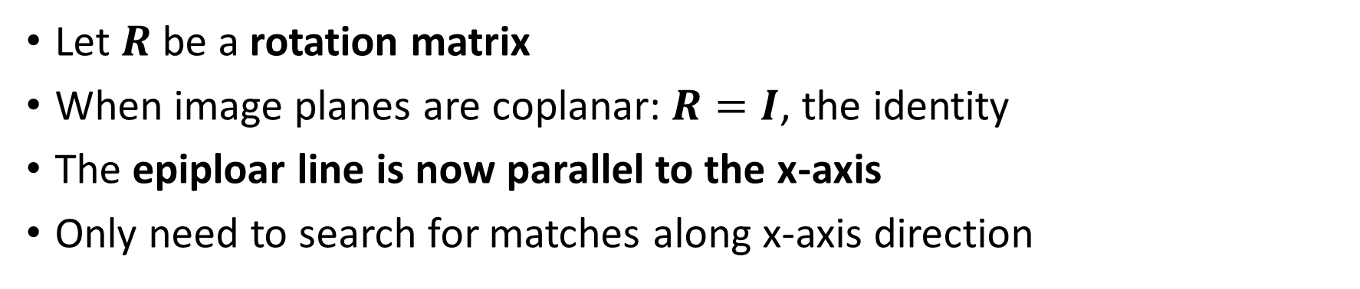
Rectification of images
How do we rectify images?
Let $R$ be a rotation matrix
When image planes are coplanar: $R=I$, the identity
The epiploar line is now parallel to the x-axis
Only need to search for matches along x-axis direction
X
x
x’
Baseline, t

Slide 31
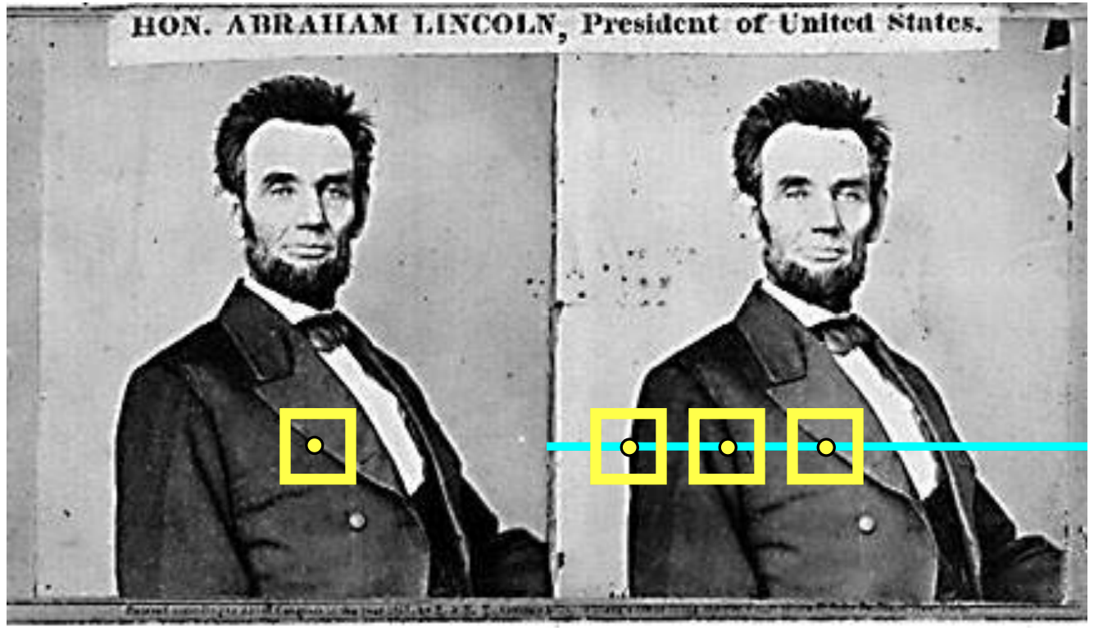
Stereo Depth Estimation
How can we create a high resolution depth map of a scene?
Start with rectified images which have horizontal epipolar lines
For each pixel in left image:
Find horizontal epipolar line on right image
Search epipolar line for matches
Compute disparity and depth

Slide 32
Limits of Depth Estimation Models

Slide 33
Stereo Depth Estimation Uses Projective Geometry
Location of points and lines in space is ambiguous in a single camera view
4 points along a line on different world planes
All 3 sets of points fall at the same points on the image plane
Slant of the line makes depth ambiguous
Prospective transformation of edge-on surface has 0 eigenvalues!
World
Plane 3
Image plane
World
Plane 1
Optical center
World
Plane 2

Slide 34
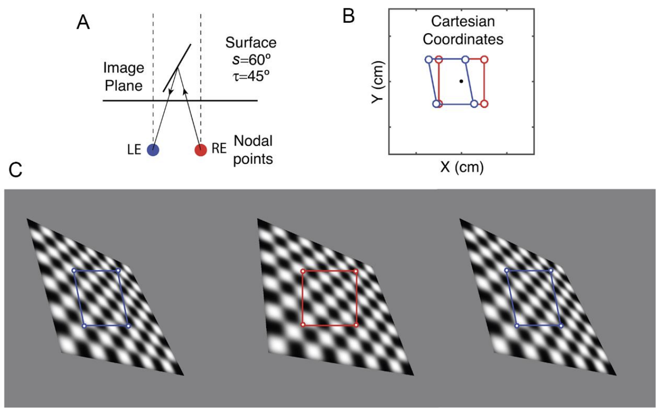
Slant Affects Stereo Depth Estimation
Slant of local surfaces can distort depth estimates
Local slant distorts coordinates
Local slant of surfaces creates ambiguity in depth
Figure from Bonnen, et.al. 2021

Slide 35
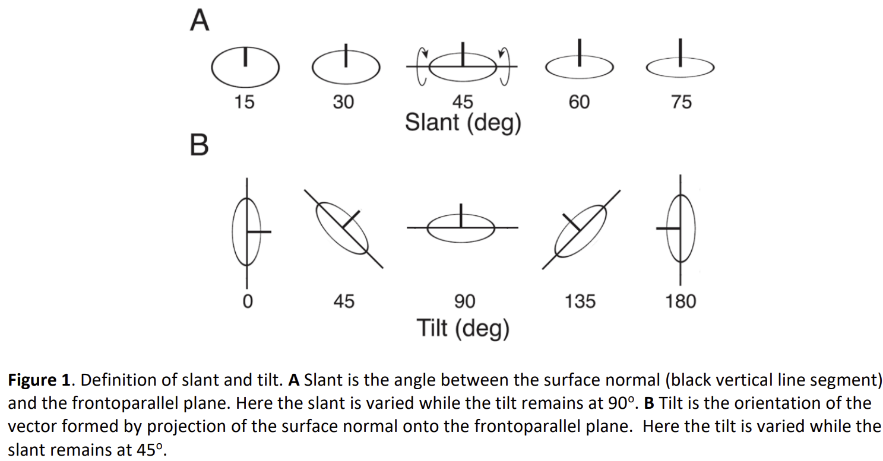
Slant Affects Stereo Depth Estimation
Slant of local surfaces can distort depth estimates
Local slant distorts geometric shapes – Example of slanted circle
Local surfaces can have both slant and tilt
Figure from Bonnen, et.al. 2021

Slide 36
Evaluation of Depth Estimation Models

Slide 37
Evaluation of Stereo Vision Models
Goal is to correctly determine disparity for each pixel of a stereo image pair
How can we find a ground truth for model evaluation?
Manual labeling
Time consuming
Often limited detail
Automatic labeling
LIDAR and RADAR directly read distance
Inherent error from sensor
Limited range and resolution
Synthetic scenes
Lack of real-world detail or complexity
Notes:
ima

Slide 38
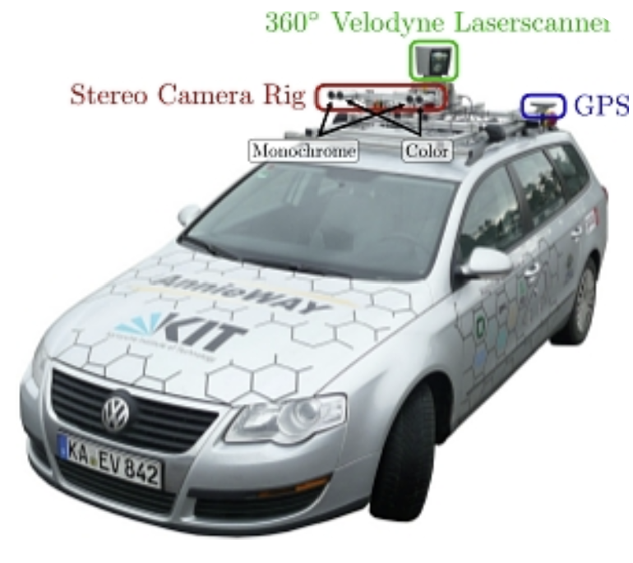
Evaluation of Stereo Vision Models
Many ways to obtain ground truth for evaluation
The KITTI autonomous driving benchmark dataset includes ground truth
Stereo black and white and color cameras collect images
Laser scanner (LIDAR) collects depth information for ground truth
Real-time sequence of stereo images collected as car moves

Slide 39
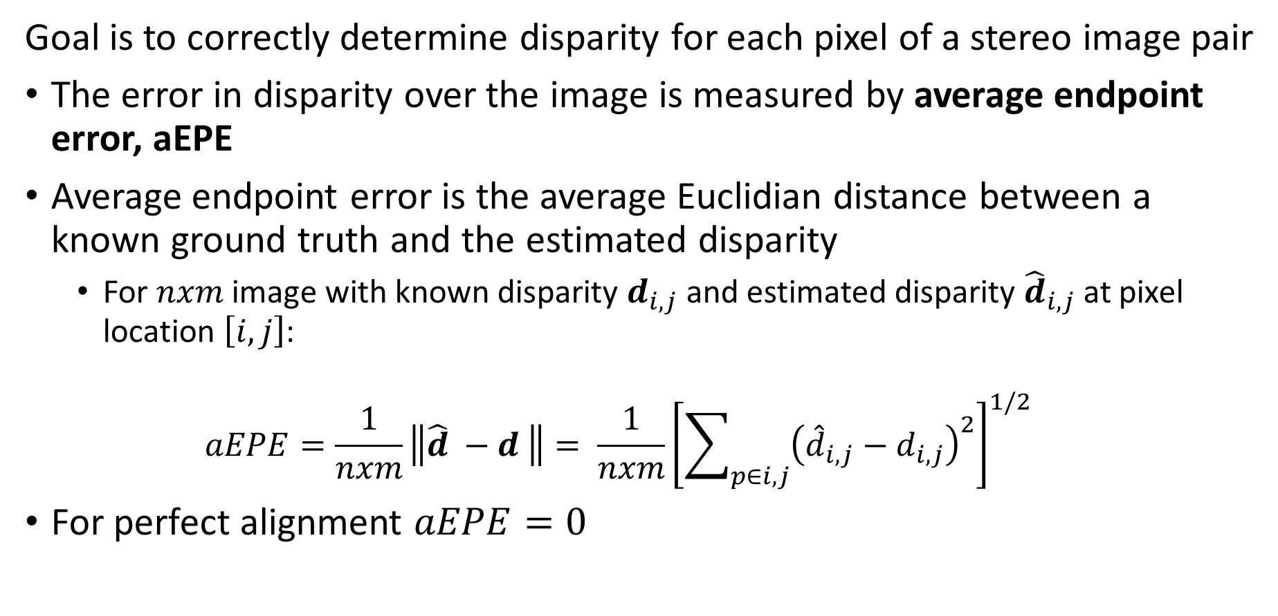
Evaluation of Stereo Vision Models
Goal is to correctly determine disparity for each pixel of a stereo image pair
The error in disparity over the image is measured by average endpoint error, aEPE
Average endpoint error is the average Euclidian distance between a known ground truth and the estimated disparity
For $nxm$ image with known disparity $d_{i,j}$ and estimated disparity ${\hat{d}}_{i,j}$ at pixel location $\left[i,j\right]$:
$$aEPE=\frac{1}{nxm}\left\|{\hat{d}}_{ }−d_{ }\right\|= \frac{1}{nxm}{\left[\sum_{p∈i,j}{{\left({\hat{d}}_{i,j}−d_{i,j}\right)}^{2}}\right]}^{1/2}$$
For perfect alignment $aEPE=0$
Notes:
ima

Slide 40
Evaluation of Stereo Vision Models
Goal is to correctly determine disparity for each pixel of a stereo image pair
Disparity estimates generally have outliers
Average endpoint error can be misleading with influence of outliers
Many metrics for outliers used to evaluate stereo vision models
Example: The KITTI datasets use several metrics, including:
D1 – Percentage of stereo disparity outliers in first frame
D2 – Percentage of stereo disparity outliers in second frame
BG – Average percent outliers in background area
FG – Average percent outliers in foreground areas
ALL – Average percent of outliers over entire image
Notes:
ima

Slide 41
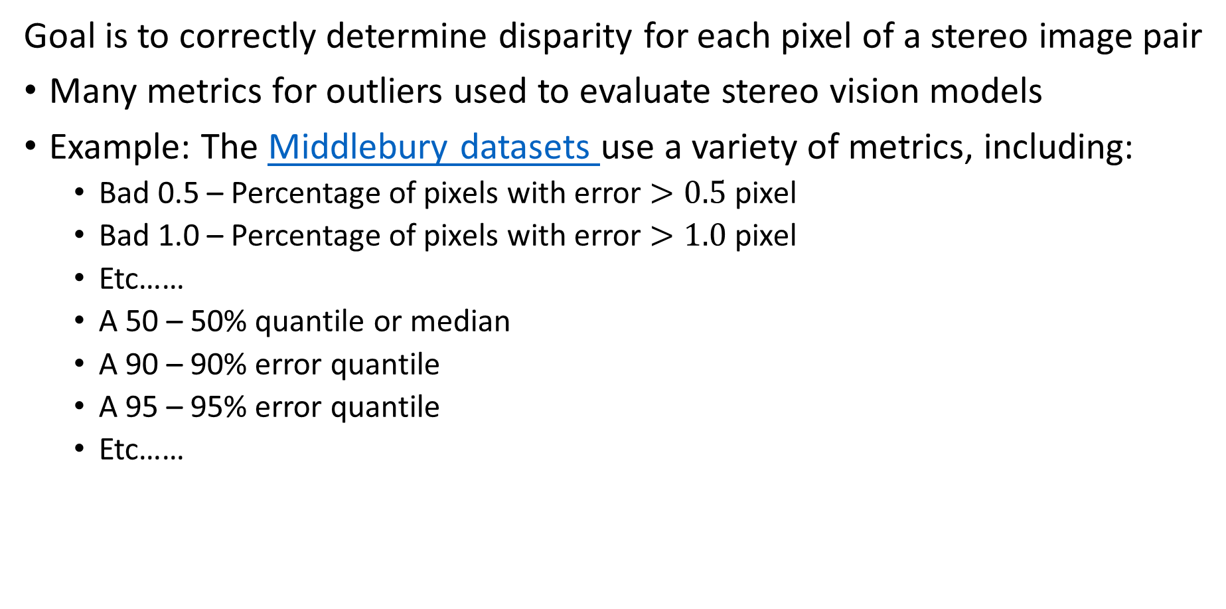
Evaluation of Stereo Vision Models
Goal is to correctly determine disparity for each pixel of a stereo image pair
Many metrics for outliers used to evaluate stereo vision models
Example: The Middlebury datasets use a variety of metrics, including:
Bad 0.5 – Percentage of pixels with error $>0.5$ pixel
Bad 1.0 – Percentage of pixels with error $>1.0$ pixel
Etc……
A 50 – 50% quantile or median
A 90 – 90% error quantile
A 95 – 95% error quantile
Etc……
Notes:
ima

Slide 42
Camera Calibration

Slide 43
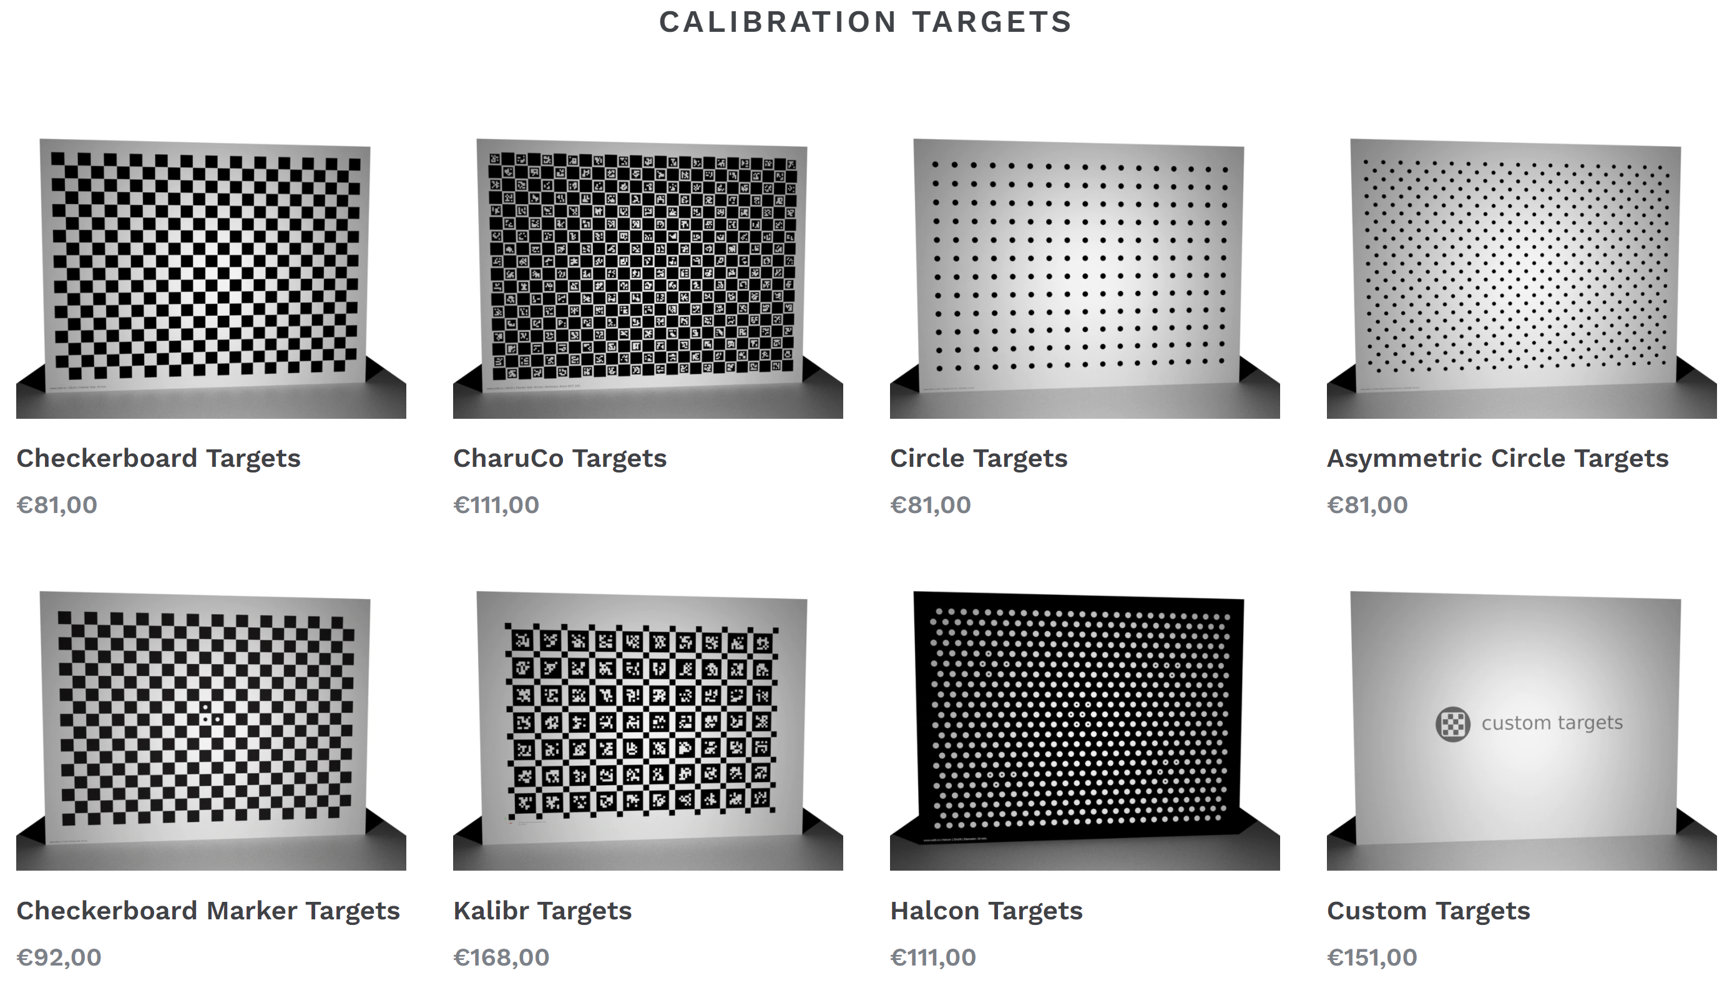
Camera Calibration
How do we calibrate camera pairs for stereo vision?
Two ways to find intrinsic parameters
Learn from multiple camera views of scene
Use multiple views of a known target
Wide variety of targets available commercially
Other suppliers

Slide 44
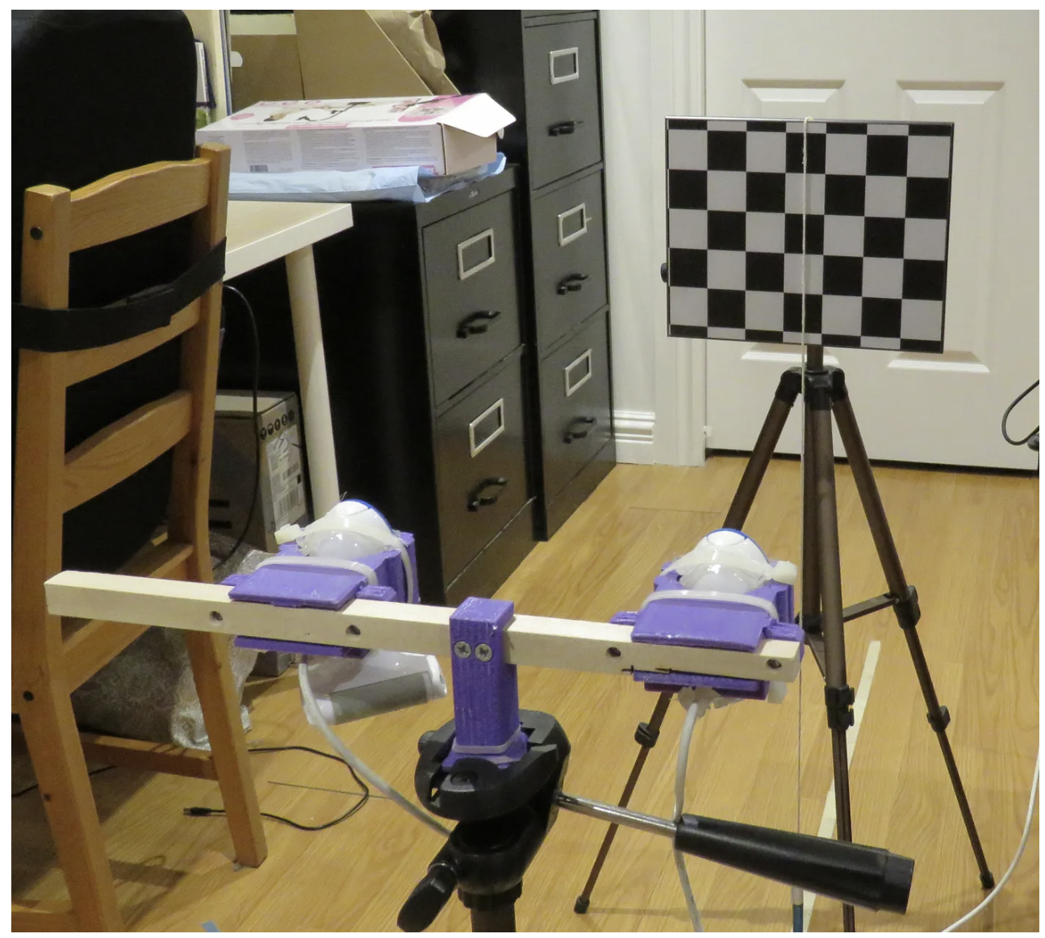
Camera Calibration
How do we calibrate camera pairs for stereo vision?
Experimental apparatus for calibrating stereo camera pairs
Camera pair directed toward a patterned target
Distances between camera lenses and distance to target from lenses are known.
From blog post by Sebastian Gilbert

Slide 45
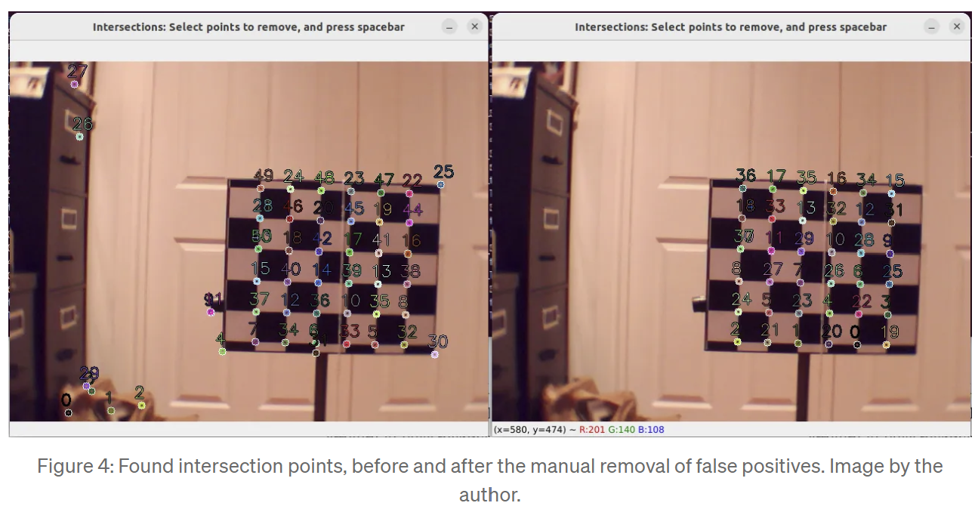
Camera Calibration
How do we calibrate camera pairs for stereo vision?
Interest points (intersections of lines) are found for each camera
Manual correction of interest point labels may be required
From blog post by Sebastian Gilbert

Slide 46
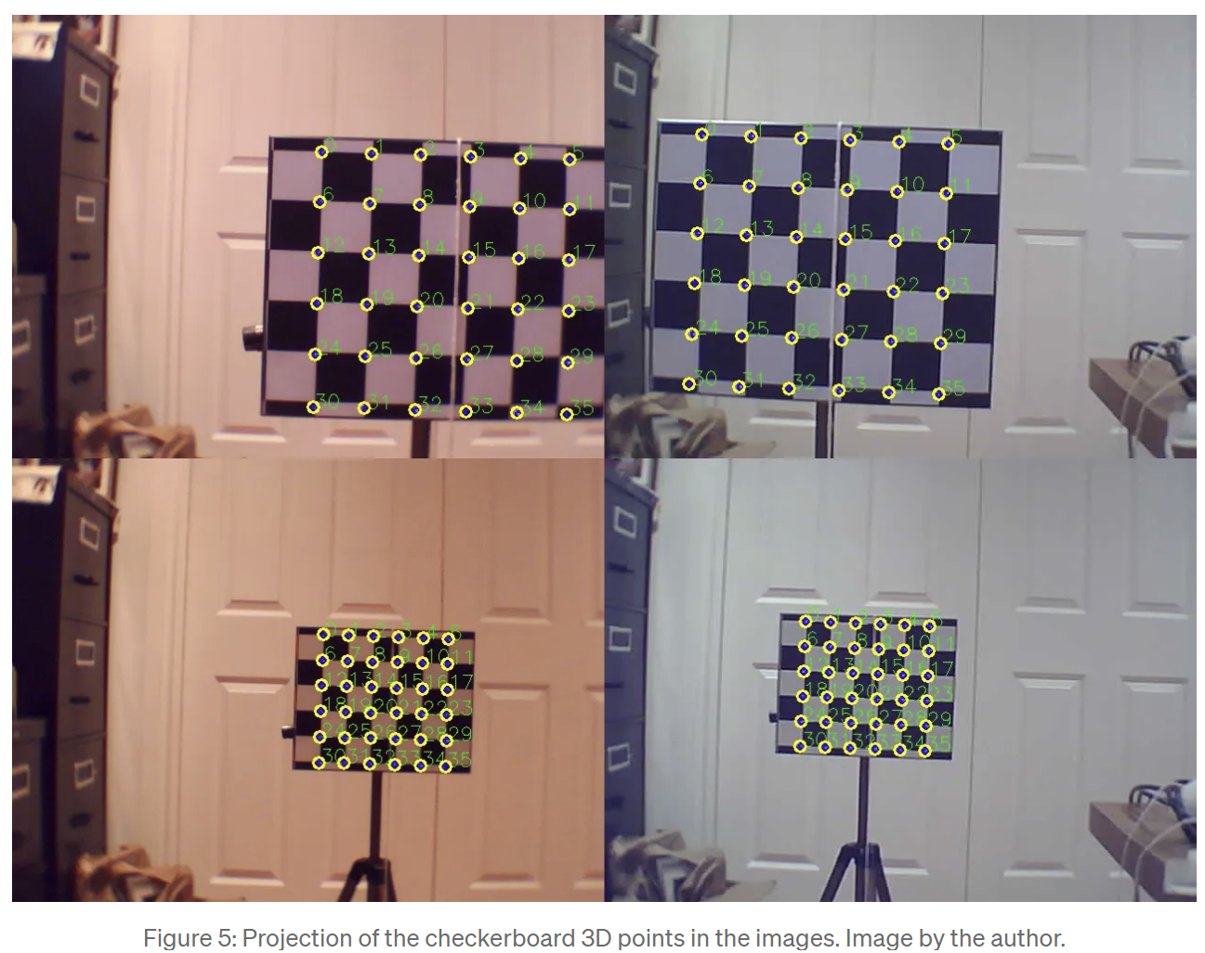
Camera Calibration
How do we calibrate camera pairs for stereo vision?
Solve linear system of equations to determine camera array calibration
Essentially an image stitching problem
From blog post by Sebastian Gilbert

Slide 47
Why Use Binocular Vision?

Slide 48
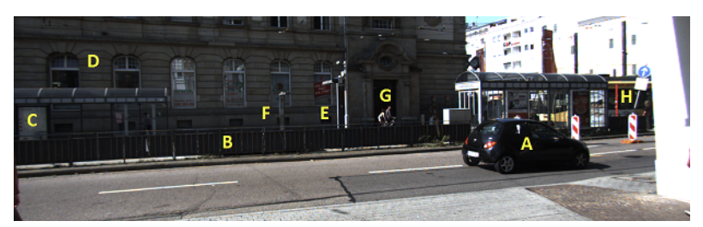
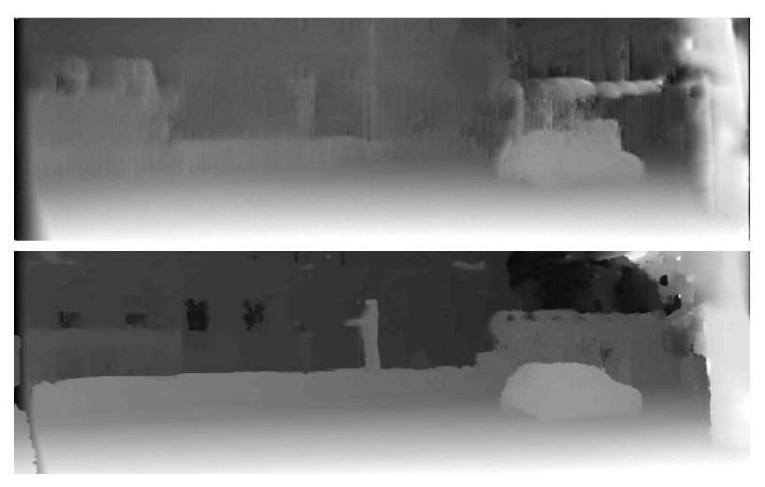
Monocular Depth Estimation
Monocular depth estimation is not competitive presently
Smolyanskiy et.al., 2020 investigated differences
Street scene with near and far label objects
Monocular depth volume of the scene – poor definition, particularly for distant objects
Binocular depth volume of the scene – higher definition, particularly for distant objects

Slide 49
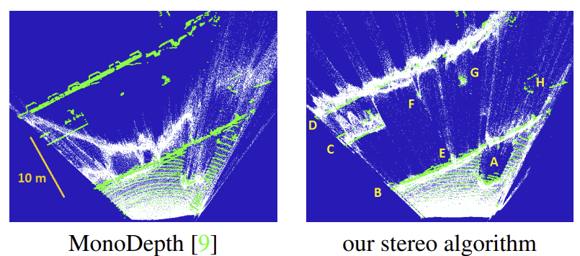
Monocular Depth Estimation
Monocular depth estimation is not competitive presently
Street scene with near and far label objects
Binocular depth gives better definition of, particularly for more distant objects
Green dots are ground truth from LIDAR
from Smolyanskiy et.al., 2020

Slide 50
Depth Estimation with Deep NNs

Slide 51
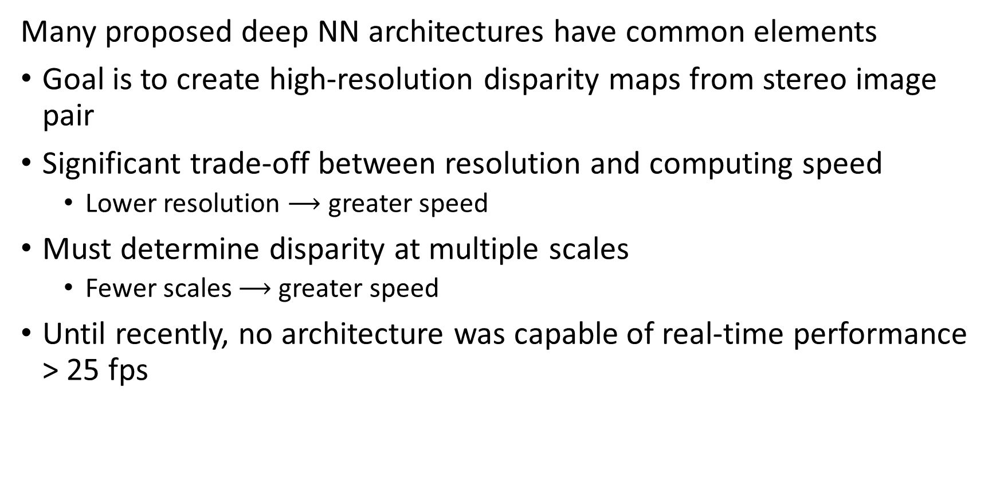
Deep Neural Nets for 3-D Depth Estimation
Many proposed deep NN architectures have common elements
Goal is to create high-resolution disparity maps from stereo image pair
Significant trade-off between resolution and computing speed
Lower resolution $⟶$ greater speed
Must determine disparity at multiple scales
Fewer scales $⟶$ greater speed
Until recently, no architecture was capable of real-time performance > 25 fps

Slide 52
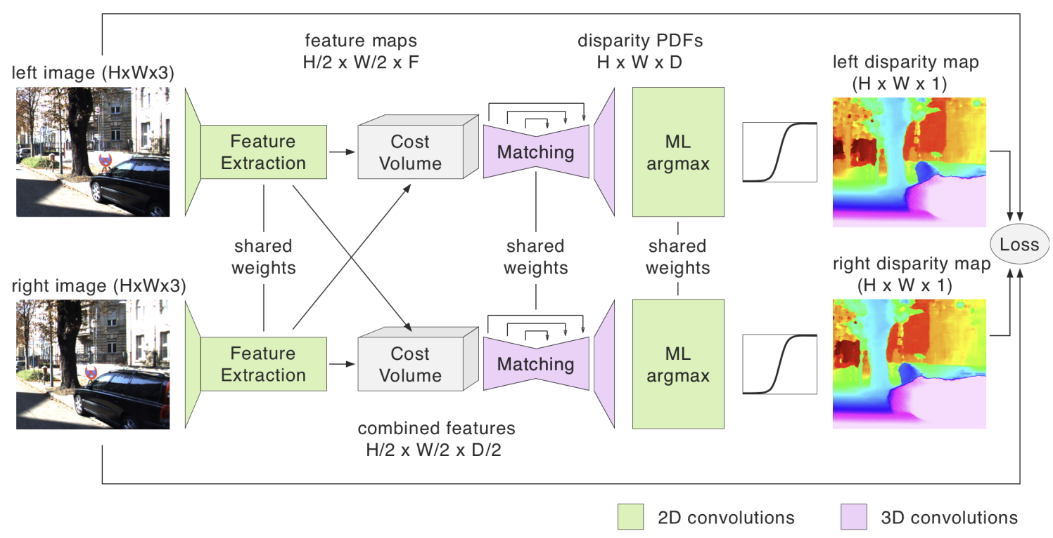
Deep Networks for 3-D Depth Estimation
Smolyanskiy et.al., 2020 proposed an improved Siamese network architecture commonality used for disparity estimation
Left and Right multi-scale feature maps, e.g. feature pyramid or encoder-decoder, such as U-Net architecture, with learned weights
Right Left input image pair

Slide 53
Deep Networks for 3-D Depth Estimation
Smolyanskiy et.al., 2020 proposed an improved Siamese network architecture commonality used for disparity estimation
Cross (interlaced) cost volumes for left and right use feature map as input and output similarity between left and right
Right Left input image pair

Slide 54
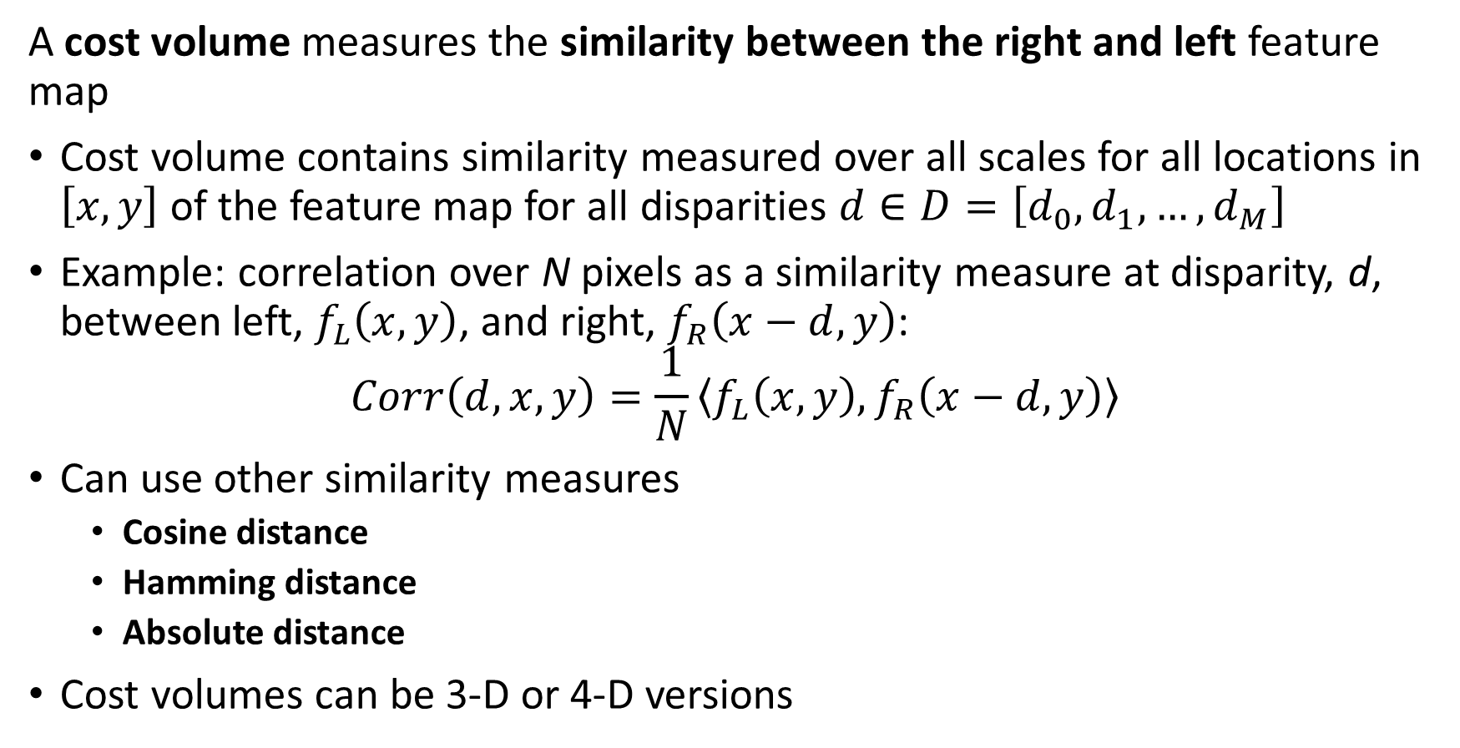
Cost Volume
A cost volume measures the similarity between the right and left feature map
Cost volume contains similarity measured over all scales for all locations in $\left[x,y\right]$of the feature map for all disparities $d∈D=\left[d_{0},d_{1},…,d_{M}\right]$
Example: correlation over N pixels as a similarity measure at disparity, d, between left, $f_{L}\left(x,y\right)$, and right, $f_{R}\left(x−d,y\right)$:
$$Corr\left(d,x,y\right)=\frac{1}{N}\left\langle f_{L}\left(x,y\right),f_{R}\left(x−d,y\right)\right\rangle$$
Can use other similarity measures
Cosine distance
Hamming distance
Absolute distance
Cost volumes can be 3-D or 4-D versions

Slide 55
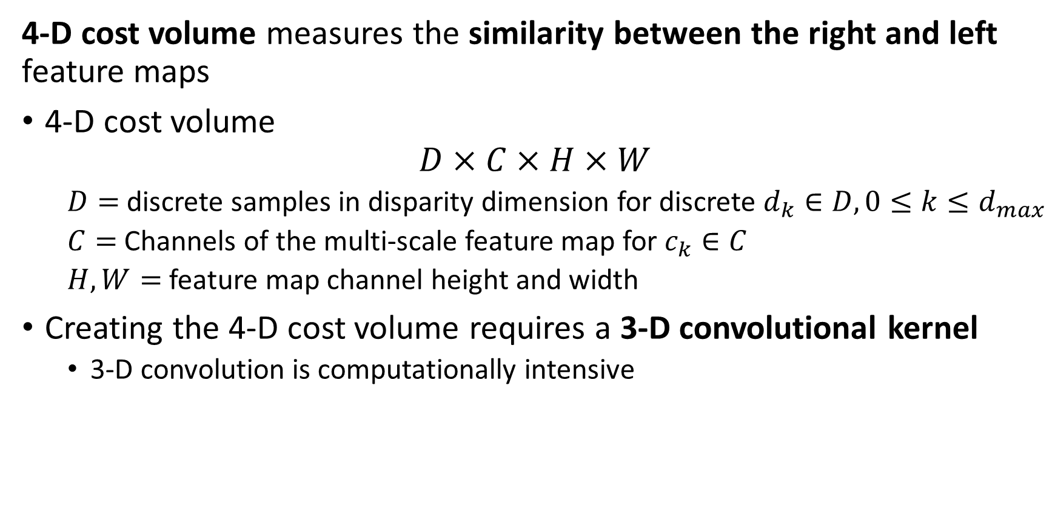
Cost Volume
4-D cost volume measures the similarity between the right and left feature maps
4-D cost volume
$$D×C×H×W$$
$D=$ discrete samples in disparity dimension for discrete $d_{k}∈D, 0≤k≤d_{max}$
$C=$ Channels of the multi-scale feature map for $c_{k}∈C$
$H,W=$ feature map channel height and width
Creating the 4-D cost volume requires a 3-D convolutional kernel
3-D convolution is computationally intensive

Slide 56
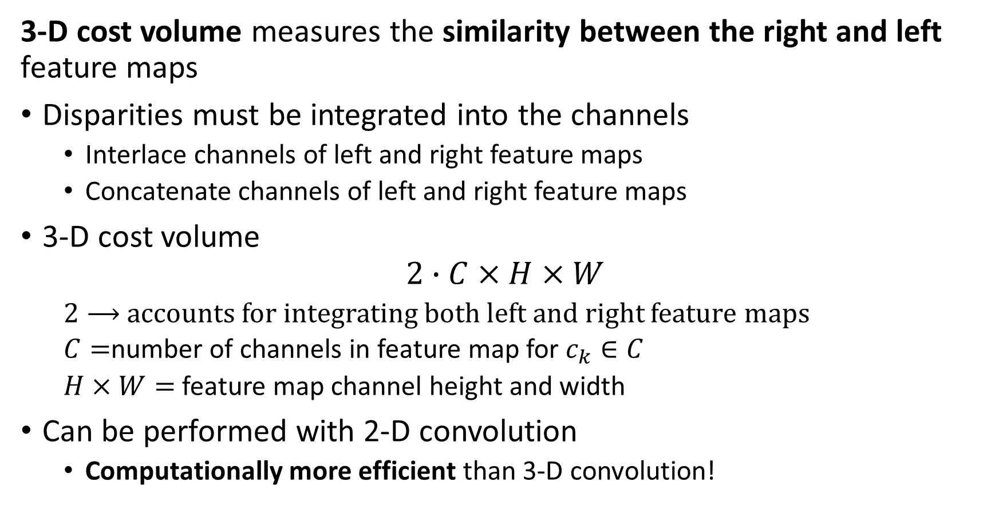
Cost Volume
3-D cost volume measures the similarity between the right and left feature maps
Disparities must be integrated into the channels
Interlace channels of left and right feature maps
Concatenate channels of left and right feature maps
3-D cost volume
$$2∙C×H×W$$
$2⟶$ accounts for integrating both left and right feature maps
$C=$number of channels in feature map for $c_{k}∈C$
$H×W=$ feature map channel height and width
Can be performed with 2-D convolution
Computationally more efficient than 3-D convolution!

Slide 57
Deep Networks for 3-D Depth Estimation
Smolyanskiy et.al., 2020 proposed an improved Siamese network architecture commonality used for disparity estimation
Matching network with one or more encoder-decoder hourglass architecture stages (or U-Net) creates up-sampled feature map integrating of cost volume at different scales. Network uses learned weights
Right Left input image pair

Slide 58
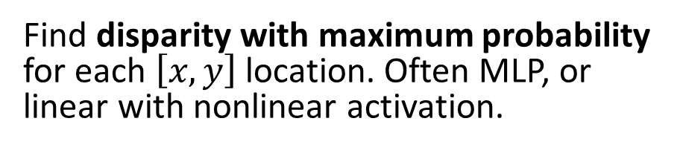
Deep Networks for 3-D Depth Estimation
Smolyanskiy et.al., 2020 proposed an improved Siamese network architecture commonality used for disparity estimation
Find disparity with maximum probability for each $\left[x,y\right]$ location. Often MLP, or linear with nonlinear activation.
Right Left input image pair

Slide 59
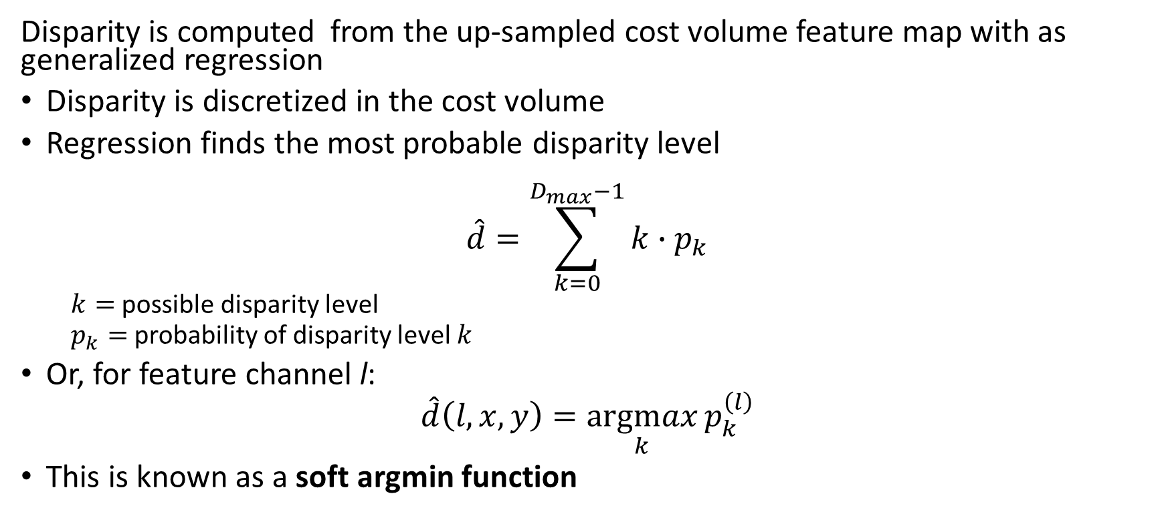
Computing Disparity
Disparity is computed from the up-sampled cost volume feature map with as generalized regression
Disparity is discretized in the cost volume
Regression finds the most probable disparity level
$$\hat{d}=\sum_{k=0}^{D_{max}−1}{k∙p_{k}}$$
$k=$possible disparity level
$p_{k}=$ probability of disparity level $k$
Or, for feature channel l:
$$\hat{d}\left(l,x,y\right)=\underset{k}{argmax}{p_{k}^{\left(l\right)}}$$
This is known as a soft argmin function

Slide 60
Deep Networks for 3-D Depth Estimation
Smolyanskiy et.al., 2020 proposed an improved Siamese network architecture commonality used for disparity estimation
Network learns to minimize loss between left and right disparity maps
Right Left input image pair

Slide 61
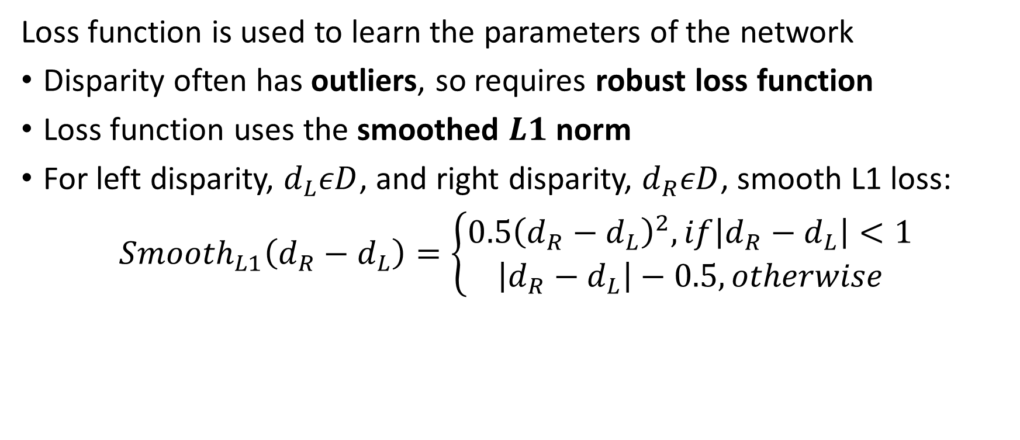
Loss function
Loss function is used to learn the parameters of the network
Disparity often has outliers, so requires robust loss function
Loss function uses the smoothed $L1$ norm
For left disparity, $d_{L}εD$, and right disparity, $d_{R}εD$, smooth L1 loss:
$${Smooth}_{L1}\left({d_{R}−d}_{L}\right)=\left\{\begin{aligned}0.5{\left({d_{R}−d}_{L}\right)}^{2}, if\left|{d_{R}−d}_{L}\right|<1 \\ \left|{d_{R}−d}_{L}\right|−0.5, otherwise\end{aligned}\right.$$

Slide 62
MobileStereoNet

Slide 63

MobileStereoNet
The MobileStereoNet of Shamsafar et. al., 2021 is a highly efficient depth estimation model
MobileStereoNet borrows architectural blocks from MobileNet
MobileStereoNet was the first NN disparity estimation architecture to operate with real-time performance low error

Slide 64


MobileStereoNet
The MobileStereoNet of Shamsafar et. al., 2021 is a highly efficient depth estimation model
MobileStereoNet has 2-D and 3-D versions
3-D MobileStereoNet creates a 4-D cost volume
2-D MobileStereoNet creates a 3-D cost volume

Slide 65


MobileStereoNet
The MobileStereoNet of Shamsafar et. al., 2021 is a highly efficient depth estimation model
For 3-D cost volume the right and left feature maps are interlaced
The interlaced features are used to compute a cost volume to determine disparity
A form of a 3-D interlaced cost volume for a general interlace metric is:
$$C_{3D}\left(x,y,d\right)=Interlace(f_{L}\left(.,x,y\right),f_{R}\left(.,x−d,y\right))$$

Slide 66

MobileStereoNet
The MobileStereoNet of Shamsafar et. al., 2021 is a highly efficient depth estimation model
V1 MobileNet 2-D convolution blocks, left, and 3-D modification, right
V2, with residual loop, MobileNet 2-D convolution blocks, left, and 3-D modification, right
V1 MobileNet
V2 MobileNet

Slide 67

MobileStereoNet
The MobileStereoNet of Shamsafar et. al., 2021 is a highly efficient depth estimation model
Use of MobileNet blocks greatly improves speed
Additional speed increase from use of 3D cost volume

Slide 68


MobileStereoNet
The MobileStereoNet of Shamsafar et. al., 2021 is a highly efficient depth estimation model
Interlaced left and right feature map converted to disparity map
Unique convolution stack per $d_{k}εD$
The number of features and scales are reduced at each groupwise convolution
The ModileStereoNet interlace function is learned

Slide 69

MobileStereoNet
The MobileStereoNet of Shamsafar et. al., 2021 is a highly efficient depth estimation model
Qualitative results
Left image and ground truth disparity in left column
Disparity error in center and right upper image
Estimated disparity map in center and right lower image

Slide 70

MobileStereoNet
The MobileStereoNet of Shamsafar et. al., 2021 is a highly efficient depth estimation model
Performance comparison with other leading models on benchmark data
MobileStereoNet achieves fast performance at cost in accuracy

Slide 71
HITnet a (nearly) State of the Art Architecture

Slide 72

HITnet
The Hierarchical Iterative Tile Refinement Network (HITnet) of Tankovich et. al., 2023, is nearly the state of the art
HITnet takes a different approach when compared to other deep NN 3-D computer vision architectures
HITnet achieves state of the art accuracy at real-time speeds

Slide 73
HITnet
The Hierarchical Iterative Tile Refinement Network (HITnet) of Tankovich et. al., 2023, is nearly the state of the art
HITnet performs disparity estimation on overlapping tiles
HITnet algorithm simultaneously estimates slant
Slant is gradient of disparity
Slant used to interpolate over regions of low gradient
Slant used to warp tiles
No need for prior image rectification step
HITS algorithm has two major steps
Initialization finds preliminary disparity and slants
Propagation improves estimates of disparity and slants with increasing resolution

Slide 74

HITnet
HITnet algorithm has two major steps
Initialization finds preliminary disparity and slants
Propagation improves estimates of disparity and slants with increasing resolution
HITnet produces disparity map and slant map

Slide 75

HITnet
Initialization step
The initial hypothesis of disparity, d, and slant is
$$h=\left[d,\frac{dd}{dx},\frac{dd}{dy},P\right]$$
Where,
Disparity $=d$
The gradient of disparity from tile slant $=\left[\frac{dd}{dx},\frac{dd}{dy}\right]$
Descriptor for tile $=P$, learned with a MLP network, $D$

Slide 76

HITnet
Initialization Step
Descriptor for tile $=P$, learned with a MLP network, $D_{l,x,y}^{int}$
$$P_{l,x,y}^{int}=D\left(ρ\left(d_{l,x,y}^{int}\right),{\tilde{e}}_{l,x,y}^{L},θ_{D_{l}}\right)$$
Where
$ρ\left(d_{l,x,y}^{int}\right)={\left\|{\tilde{e}}_{l,x,y}^{L}−{\tilde{e}}_{l,x,y}^{R}\right\|}_{1}$, disparity cost
${\tilde{e}}_{l,x,y}^{L}=$ left feature map
$θ_{D_{l}}=$ learned parameters of MLP
Learned descriptors are powerful and more general than hand-engineered descriptors

Slide 77

HITnet
HITnet uses sets of overlapping tiles to compute disparity at several scales
Initialization step
Encoder-decoder down-up samples left input image using 4x4 convolution with 4x4 stride to create overlapping tiles at each scale
Encoder-decoder down-up samples right input image using 4x4 transposed convolution with 4x1 stride to create non-overlapping reference tiles at each scale

Slide 78

HITnet
HITnet uses sets of overlapping tiles to compute disparity at several scales
Initialization step
Robust matching of tiles at multiple scales in the cost volume – only store top matches
At resolution, l, the cost function is $ρ\left(d,l,x,y\right)={\left|{\hat{e}}_{l,x,y}^{L}−{\hat{e}}_{l,4x−d,y}^{R}\right|}_{(1)}$
Initial match found as $d_{l,x,y}^{init}=\underset{d∈[0,D]}{argmin}{ρ\left(d,l,x,y\right)}$
Initial matches at multiple scales

Slide 79


HITnet
HITnet employs multiple propagation steps to improve disparity estimates
$4×4$ disparity volume for warping each tile from disparity gradient is computed
$${d′}_{x,y}=d+\left(i−1.5\right)d_{x}+\left(j−1.5\right)d_{y}$$
The cost volume, $φ\left(e_{l}, d′\right)=\left[c_{0,0},c_{0,1},…,c_{0,3},{…,c}_{1,0},…,c_{3,3}\right]$
$$c_{i,j}={\left|{\hat{e}}_{l,4x+1,4y+j}^{L}−{\hat{e}}_{l,4x+1−{d′}_{i,j},4y+j}^{R}\right|}_{(1)}$$

Slide 80
HITnet
HITnet employs multiple propagation steps to improve disparity estimates
At each step the disparity gradient is used to warp the tiles to correct for slant at the scale
Incremental tile hypothesis improvement learned from cost volume
Interpolation during propagation to achieve subpixel accuracy
Full detail in the paper

Slide 81

HITnet
HITnet tests multiple hypotheses at each propagation step
Initialization hypothesis and disparity map
Higher resolution initialization and propagation hypotheses and warp
Lower resolution disparity map and hypothesis
Tile warping using initialization and coarse propagation hypotheses
Higher resolution disparity map

Slide 82

HITnet
HITnet progressively estimates disparity and slat at multiple scales
Initialization disparity computed at multiple scales
Resolution of disparity and slat maps progressively increases during propagation

Slide 83
Summary of 3-D Computer Vision
Key points
Stereo vision is based on epipolar geometry
Disparity is on the x-axis for rectified image pairs
Endpoint error used to evaluate disparity models
Binocular vision models are inherently more accurate than monocular vision
Deep neural networks estimate disparity at multiple scales
Cost volume contains similarity estimates for feature map
Disparity estimated by argmin of matched similarity
MobileStereoNet and HITnet are (nearly) state-of-the-art real-time disparity estimation models

